Slide 1
All you have to know about the project

Slide 2
What it is all about?
Happy Bus is a summer project aiming at providing children from rural
areas with creative leisure activities during school break.
Unfortunately vacation from work is shorter than vacation from school, and
even if the parents would like to stay home with their kids, they have to go do
their job. Children usually stay alone and it’s not rare that they spend most of
the time by a computer screen or a TV. It makes all the days seem completely
boring and alike – but should summertime not be full of adventures and new
experiences?
Happy Bus is supposed to be a solution to this problem. We want to give
children who stay at home a reason to go out – we want them to join our
outdoor activities, we want them to self-improve, to discover the world and at
the same time have some great fun.
WEBSITE: www.happykids.org.pl
FB: www.facebook.com/happybusFundacjaHappyKids/
ADRES: ul. Żniwna 10/14 94-250 Łódź
NIP: 727-25-72-926 REGON: 473079676 KRS: 0000133286

Slide 3
What it is all about?
This year we also have a special goal. Our foundation is deeply engaged in evacuation of orphans from territories that are currently undergoing the worst war actions in Ukraine. Therefore there's around 1200 orphans in Poland that we are taking care of. We want to provide them with something that would take their innocent minds off the situation in their homeland and will bring them some joy.
Except for the kids we are taking care of, there are also thousands of refugees who would love this opportunity for their children.
That's why its even more important this year to reach as many participants as possible.
WEBSITE: www.happykids.org.pl
FB: www.facebook.com/happybusFundacjaHappyKids/
ADRES: ul. Żniwna 10/14 94-250 Łódź
NIP: 727-25-72-926 REGON: 473079676 KRS: 0000133286

Slide 4
What it is all about?
For the exact reasons stated above, we are proudly working on conducting the 12th edition of the project in the summer of 2022.
The attractions we offer include animations and games, both for younger and older participants. Sports, face painting, creating unique acessories – these are only a little part of what we’re doing in the villages with kids. Moreover we have equipment that consists of bouncy castles, sledges, trampolines and most importantly the bus with a built-in playground.

Slide 5
What will you do as a volunteer?
1. As a volunteer your main task will be to take care of children who come to play with us. Some of them will join us with their parents, but most of them will come alone – we have to make sure they are safe and happy.
2. We'll also need you to organise/participate in games, competitions and animations for kids to keep them entartained.
3. Face painting and hair styling is one of the attractions available. It's okay if you don't feel skilled – we guarantee children will be over the moon with the simpliest drawings on their skin (we'll teach you)
4. Another thing we offer is English lessons – We divide children in groups and each of them gets a teacher – you! (no worries if your English isn't perfect, it's just about contact with the language)
5. We would like you to be able to make a short presentation about your country – That's why we'd appreciate if you bring the flag of your country with you and if possible, some pictures or videos of traditions and interesting things about your country.
6. Another responsibility (very important!) we all have during the project is to keep the space we work in (and the space we live in) clean. You must to be okay to grab a broom or a mop from time to time.

Slide 6
WEBSITE: www.happykids.org.pl
FB: www.facebook.com/happybusFundacjaHappyKids/
ADRES: ul. Żniwna 10/14 94-250 Łódź
NIP: 727-25-72-926 REGON: 473079676 KRS: 0000133286
What’s the working system?
We work in a 3-1 system (3 working days, 1 day off) from 9.30 a.m. to 5.30 p.m.
- 3 days of work in one village/city
- 1 day-off when we can go sightseeing or take some rest or go to a lake/river
- 3 days of work in another village/city
and that's how it goes:)
We are also planning 2/3 days-off in a row when you can go to other places you would like to visit.

Slide 7
What do we offer?
- Food and accommodation (described below)
- Possibility to improve your language skills
- Support of coordinators and mentors
- Possible trainings for you before the project (for example first aid course)
- Possibility to make friendships all over the world
- Possibility to get to know what Poland really is like, especially in rural areas
- Integration parties
- Recreational trips from time to time on days off

Slide 8
Food and accommodation
Food
We provide food for breakfast and dinner which is free to use for volunteers. During working days each volunteer gets one
fresh, warm meal.
During our days-off volunteers can either eat something with the team (it's provided) or arrange their own meal (and pay for it themselves)
Accommodation
In each village we have a different accommodation so sometimes it’s a hostel, sometimes a campsite, another time a gym where we sleep on mattresses on the floor. You have to be prepared to sleep in variety of places, so take a sleeping bag and a pillow with you.
We don’t cover your accommodation if you decide you want to go to another city for tourism (unless it's us who organize the trip).
WEBSITE: www.happykids.org.pl
FB: www.facebook.com/happybusFundacjaHappyKids/
ADRES: ul. Żniwna 10/14 94-250 Łódź
NIP: 727-25-72-926 REGON: 473079676 KRS: 0000133286

Slide 9
Who can apply?
- Everyone aged 18-30
- Everyone who can communicate in English;
- Everyone who wants to promote their culture and language in another country;
- Everyone who wants to make a difference for thousands of children;
- Everyone who is not afraid to meet new people with other religions and habits;
- Everyone who wants to discover smaller and bigger cities in Poland;
- Everyone who can follow rules and be a part of a team;
- Everyone who likes to have fun and can share it with others.
WEBSITE: www.happykids.org.pl
FB: www.facebook.com/happybusFundacjaHappyKids/
ADRES: ul. Żniwna 10/14 94-250 Łódź
NIP: 727-25-72-926 REGON: 473079676 KRS: 0000133286

Slide 10
We'll be glad if you identify with one or more of the following:
You like taking pictures and you know how to do it
You like to do sports (especially team sports) and you can play it with kids
You feel confident with children of all ages or you have some experience working with kids
You can conduct some kind of workshops (artistic, handcrafting etc.)
You know first aid
You have artistic skills
You have a driving license
You have some volunteering experience
You enjoy working in a team

Slide 11
Basic rules during project:
Happy Bus is a volunteering project, which means you won’t get
paid for your work;
As our team consists of people from all over the world, you must be polite and tolerant for everyone;
All volunteers take care of their own safety, other volunteers, and children who participate in the project;
Alcohol or other psychoactive substances are forbidden during all the project;
You can’t smoke cigarettes with visible logo of Happy Kids Foundation;
The volunteer is obliged to respect the quiet hours between 10 p.m. and 6 a.m. in the morning.
WEBSITE: www.happykids.org.pl
FB: www.facebook.com/happybusFundacjaHappyKids/
ADRES: ul. Żniwna 10/14 94-250 Łódź
NIP: 727-25-72-926 REGON: 473079676 KRS: 0000133286

Slide 12
Stages of the project
Introduction | Main phase | Final stage
2-4 first days after arrival you're gonna spend in the city od Lodz, central Poland. We will take care of the final paper work, introduce you to the team and let you integrate. We are also going to show you all our equipment and we'll explain to you in details what the work is gonna be like. Accommodation and food will be provided with local families that create our Happy Kids association society. | The main phase begins when we depart from the city and start visiting villages. We'll stay 3 days in each village and work with children there. Then we'll have one day off work and then we start over in another village. It's important to note that moving from one village to another sometimes takes part on the last day of work in the evening or sometimes on the day off. We are going to provide you with 1-2 longer breaks during the project (2-3 days) so you can use it for travel if you want. | The final stage of the project consists of the grande finale (which is going to be a pretty big festival). After that we all return to the city of Lodz for 1-3 nights. We'll organise a goodbye party there for the team and thank you all for the amazing time together.

Slide 13
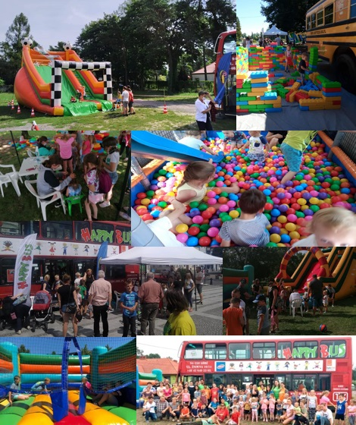
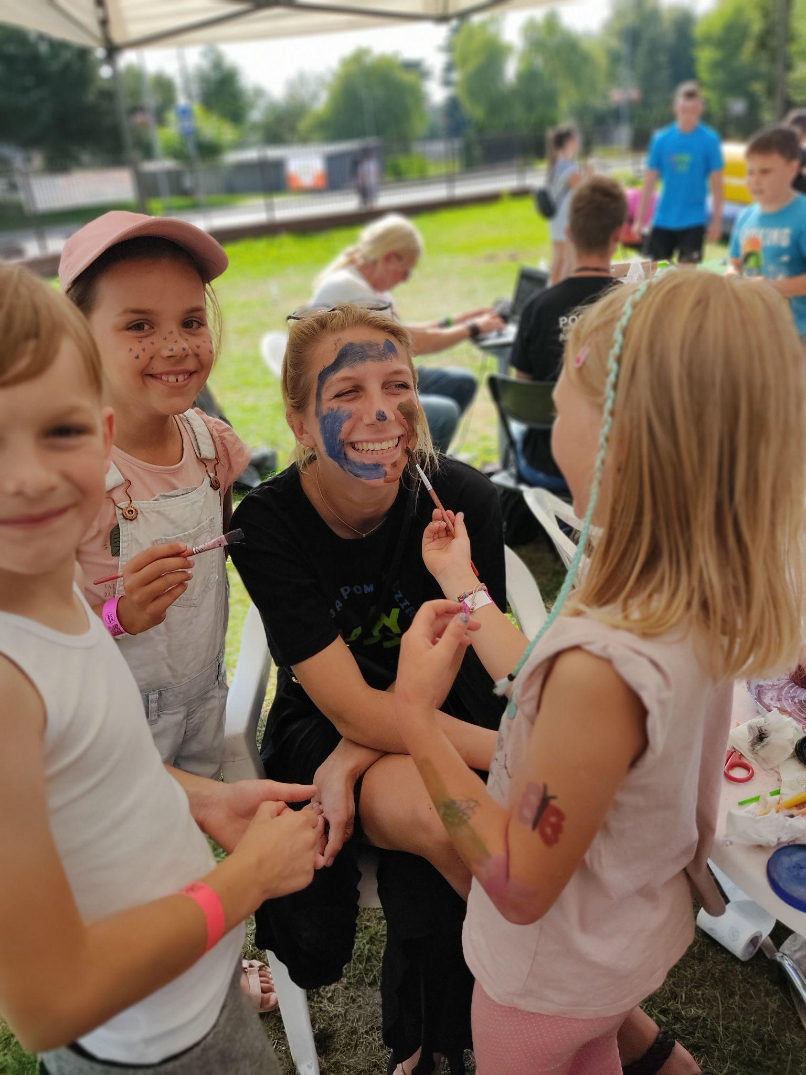
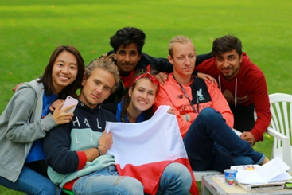
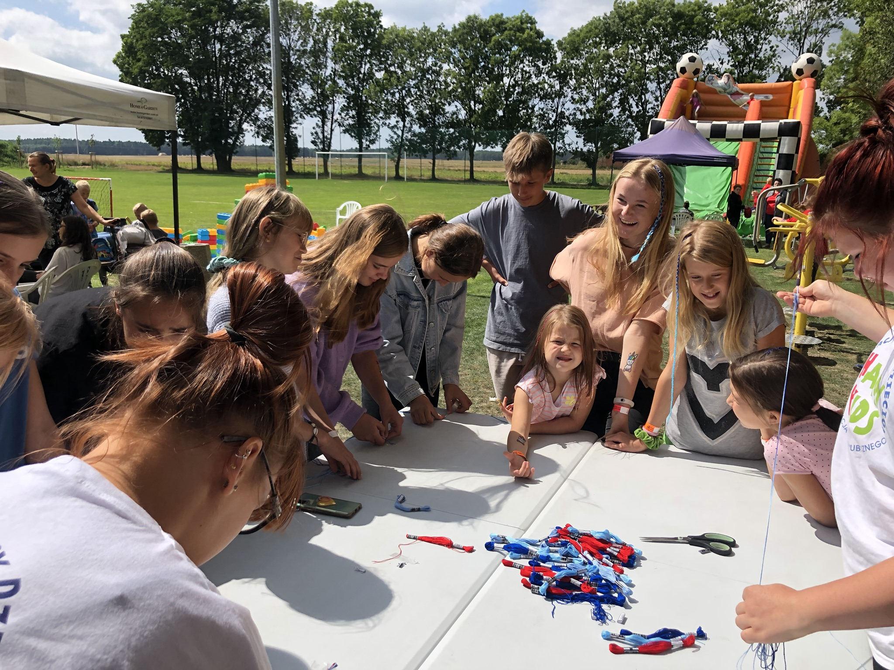
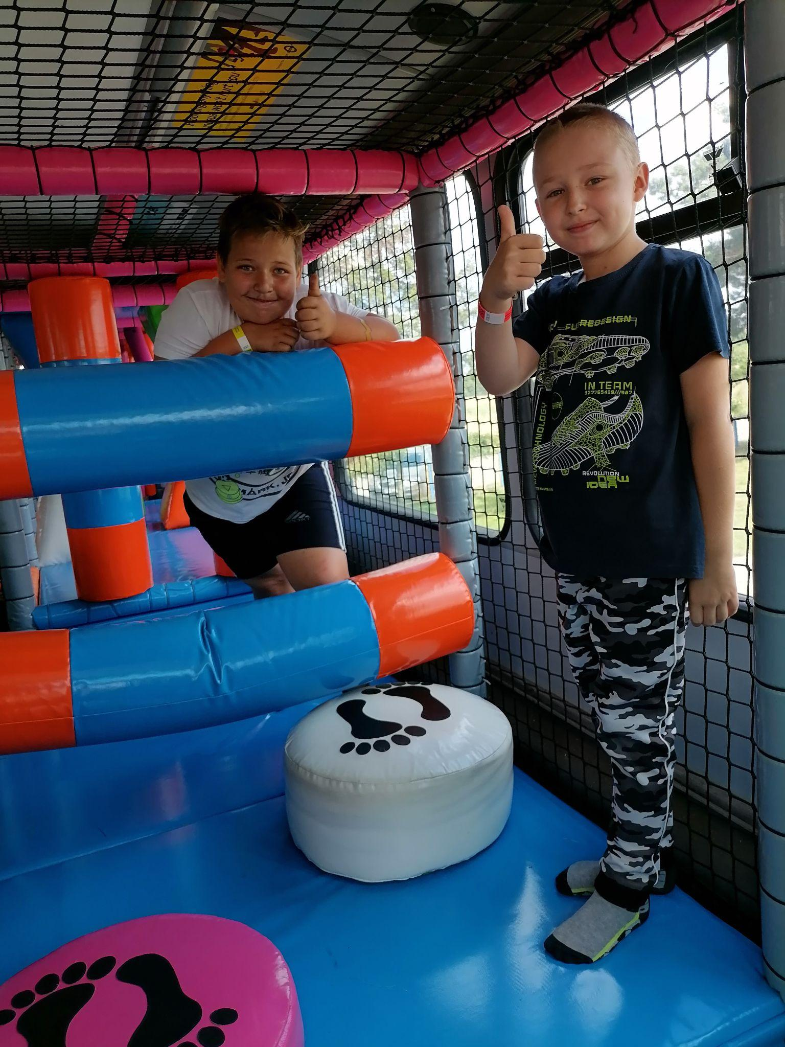
Photos from previous editions

Slide 14
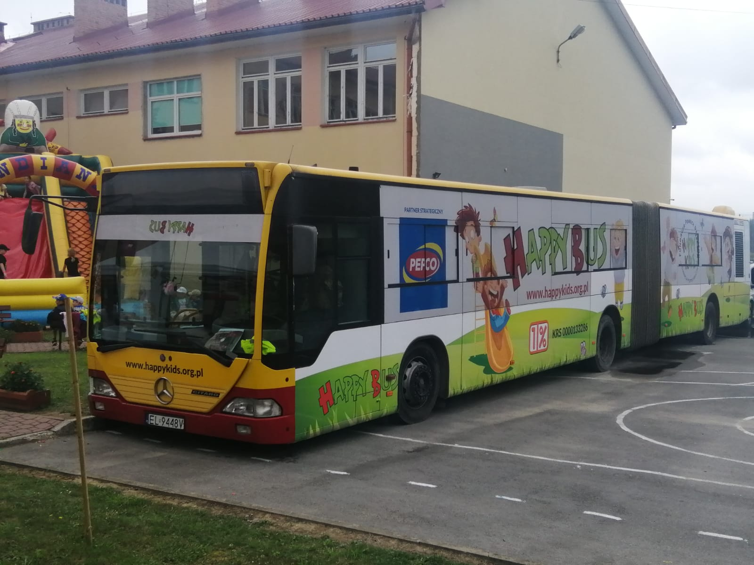
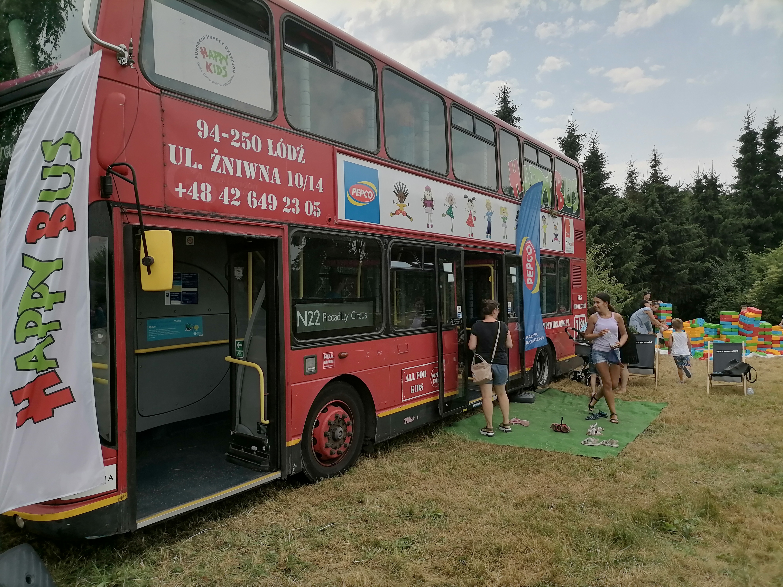
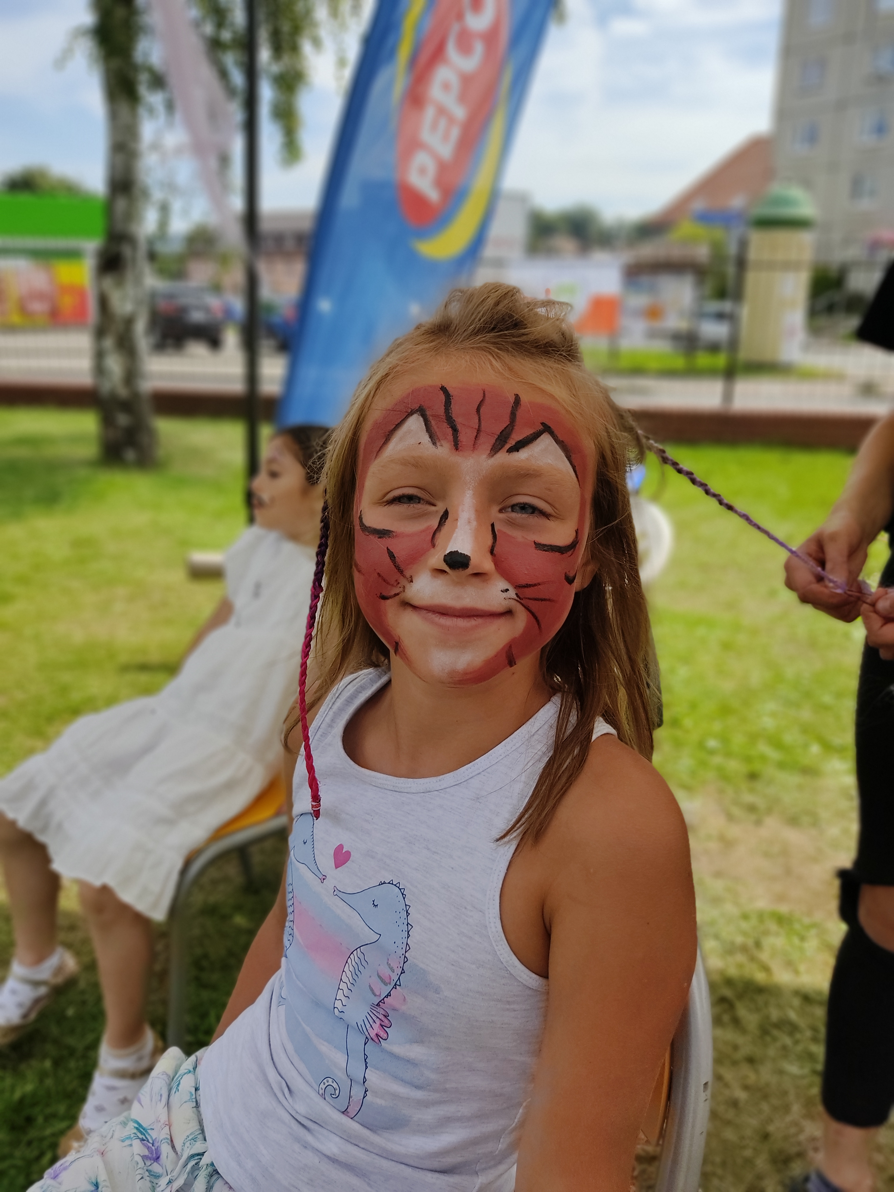
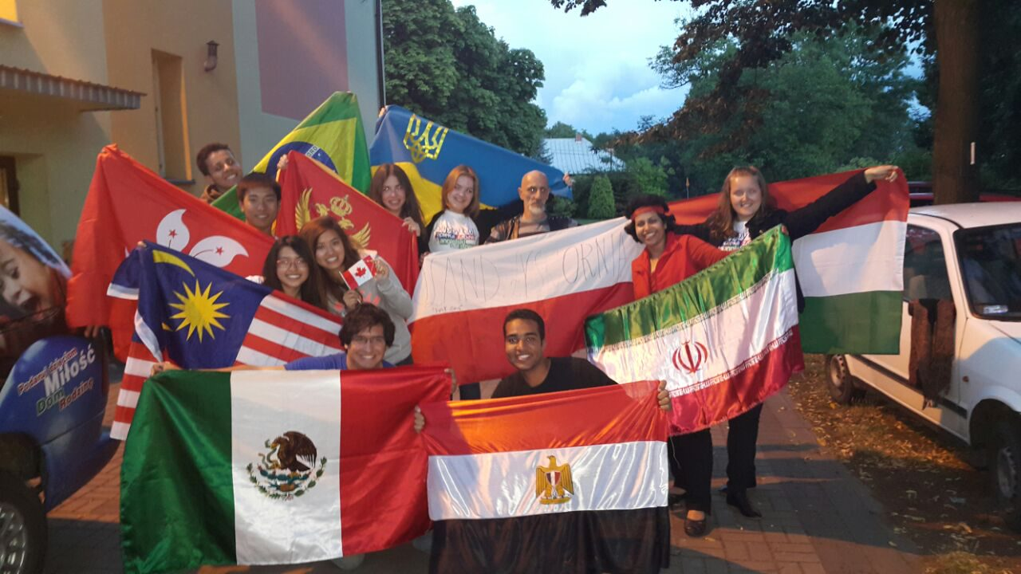
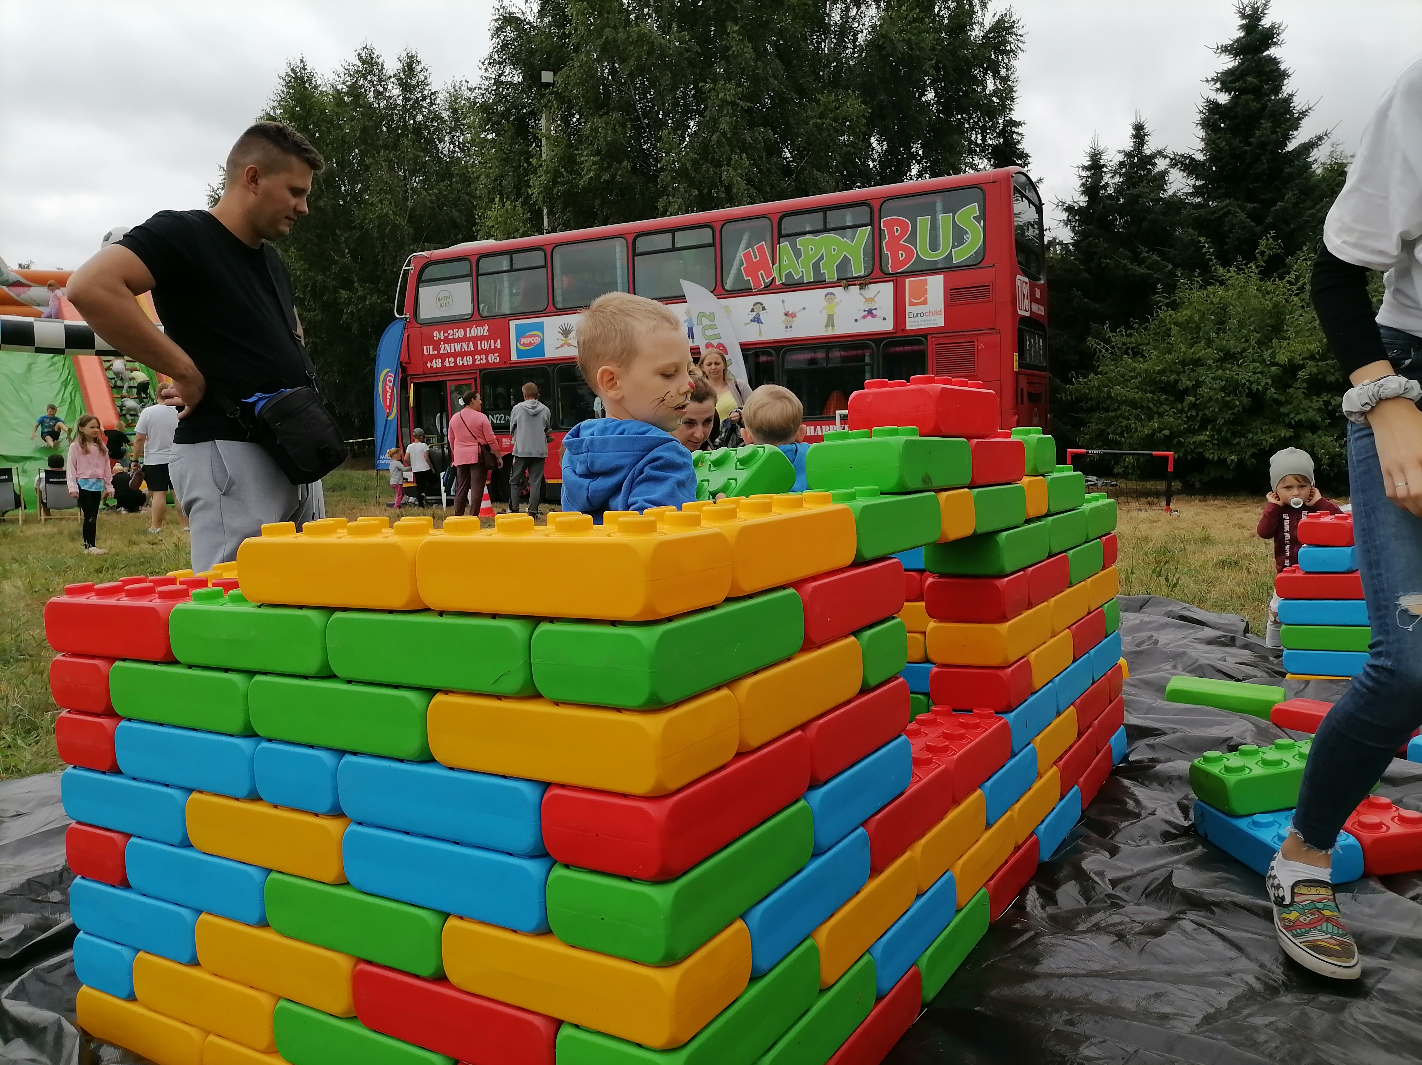
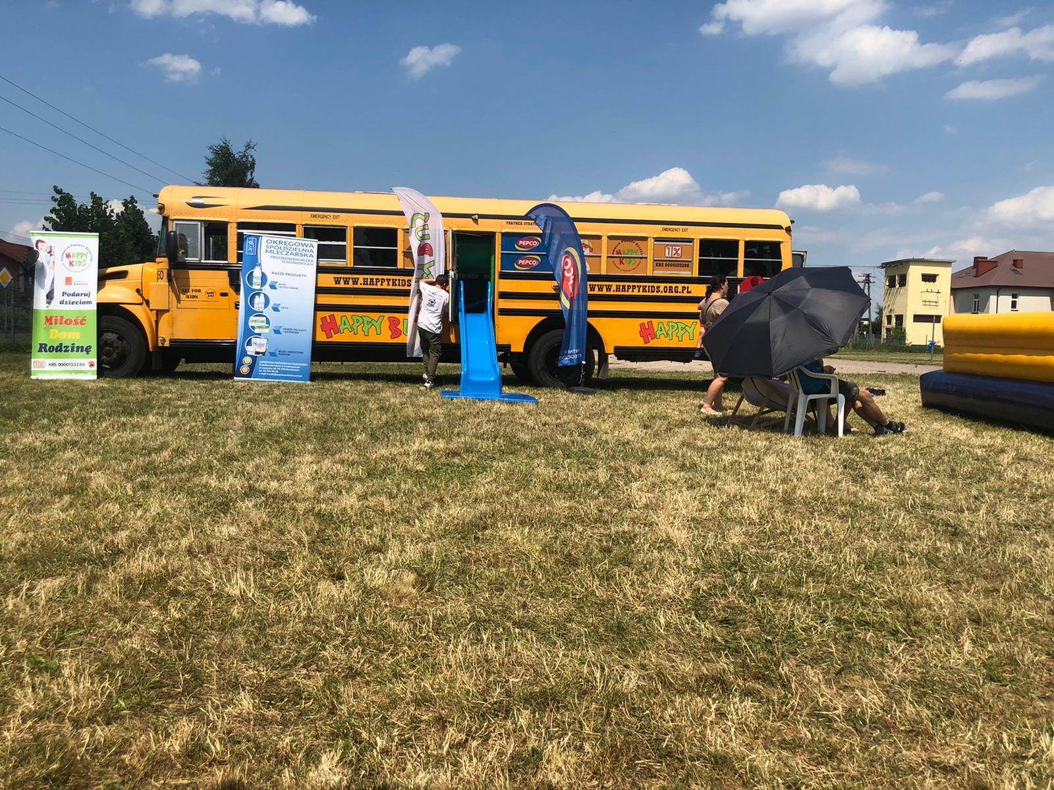
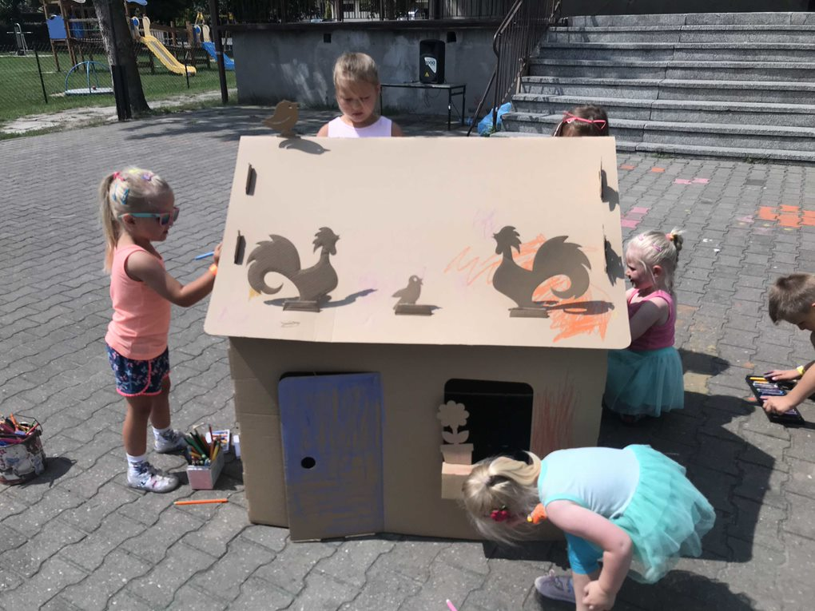

Slide 15
How to apply?
All you have to do to apply is to fill in this form:
https://forms.office.com/r/PBUugcJtHu
Ten we'll contact you and we'll invite you for a conversation about details. That's when we answer all of your questions.
After that it's time for a decision:)
Simple as that!

Slide 16
We can't wait for you to join us!
WEBSITE: www.happykids.org.pl
FB: www.facebook.com/happybusFundacjaHappyKids/
ADRES: ul. Żniwna 10/14 94-250 Łódź
NIP: 727-25-72-926 REGON: 473079676 KRS: 0000133286

